Slide 1





Noida Institute of Engineering and Technology, Greater Noida
Quality Concepts
Unit: 2
TOTAL QUALITY MANAGEMENT
DHEERAJ TRIPATHI
Assistant Professor
Department of Electronics and Communication Engineering
SUBJECT CODE: AOE0861
B Tech VIII Sem

Slide 2

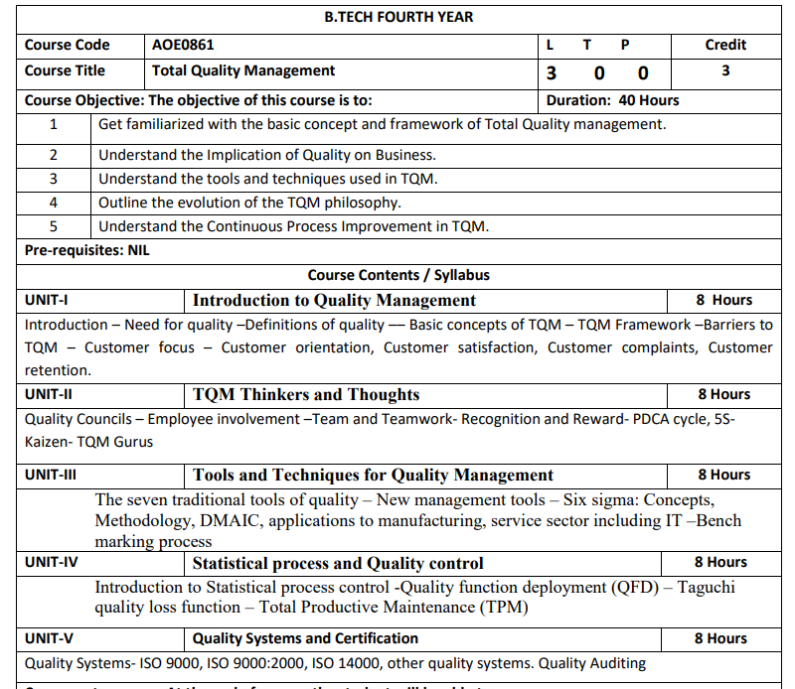
SYLLABUS

Slide 3
CONTENTS
Course objectives
Course outcomes
Program Outcome
CO-PO Mapping
Program Specific Outcome
CO-PSO Mapping
Program Educational Objectives
Recap and precap
Syllabus of Unit 2
recap of Deming point
objective of TQM
TQM details.
Recap of TQM
objective of Quality councils
Quality councils

Slide 4
CONTENTS
Recap of Quality councils
Objective of Quality cost
Quality cost
Recap of Quality cost
Objective of team
Team
Video links
Daily quiz
Weekly assignments
MCQs
Old question papers
Expected questions for university exam
Summary

Slide 5
COURSE OBJECTIVES
AOE0861.1 | To learn about common term Quality Concepts
AOE0861.2 | To know TQM principle
AOE0861.3 | To understand the importance of different chart like P-charts and C-charts
AOE0861.4 | To know new term PDCE cycle, 5S,Kaizen
AOE0861.5 | To be aware about different ISO standards and JIT

Slide 6
COURSE OUTCOMES
AOE0861.1 | Define the Quality Concepts and Manufacturing Quality
AOE0861.2 | Conceptualize the term Quality Management and relate to this various TQM Principles
AOE0861.3 | Analyze the different Tools and Techniques and Control Charts
AOE0861.4 | Distinguish between Defects Diagnosis and Prevention term
AOE0861.5 | Coordinate IS0 and its concept to Quality Management

Slide 7
PROGRAM OUTCOME
1. Engineering knowledge
2. Problem analysis
3. Design/development of solutions
4. Conduct investigations of complex problems
5. Modern tool usage
6. The engineer and society
7. Environment and sustainability
8. Ethics
9. Individual and team work
10. Communication
11. Project management and finance
12. Life-long learning

Slide 8
CO-PO Mapping
CO | PO1 | PO2 | PO3 | PO4 | PO5 | PO6 | PO7 | PO8 | PO9 | PO10 | PO11 | PO12
AOE0861.1 | 3 | 3 | 2 | 2 | 1 | 2 | 2 | 1 | 1 | 1 | 2 | 3
AOE0861.2 | 3 | 3 | 3 | 3 | 2 | 2 | 2 | 1 | 1 | 1 | 2 | 3
AOE0861.3 | 3 | 3 | 2 | 3 | 3 | 2 | 2 | 1 | 2 | 1 | 2 | 3
AOE0861.4 | 3 | 2 | 3 | 2 | 2 | 2 | 2 | 1 | 2 | 1 | 3 | 3
AOE0861.5 | 3 | 2 | 3 | 2 | 2 | 2 | 2 | 1 | 2 | 1 | 2 | 3
Avg | 3 | 2.6 | 2.6 | 2.4 | 2 | 2 | 2 | 1 | 1.6 | 1 | 2.2 | 3

Slide 9
PROGRAM SPECIFIC OUTCOME
On successful completion of graduation degree, The computer Science & Engineering graduates will be able to:
PSO1: identify, analyze real world problems and design their ethical solutions using artificial intelligence, robotics, virtual/augmented reality, data analytics, block chain technology, and cloud computing.
PSO2: design and develop the hardware sensor devices and related interfacing software systems for solving complex engineering problems.
PSO 3: understand inter-disciplinary computing techniques and to apply them in the design of advanced computing.
PSO 4: conduct investigation of complex problem with the help of technical, managerial, leadership qualities, and modern engineering tools provided by industry sponsored laboratories.

Slide 10
CO- PSO Mapping
CO | PSO1 | PSO2 | PSO3
AOE0861.1 | 3 | 2 | 3
AOE0861.2 | 3 | 2 | 2
AOE0861.3 | 3 | 2 | 3
AOE0861.4 | 3 | 3 | 3
AOE0861.5 | 3 | 2 | 3
Avg | 3 | 2.2 | 2.8

Slide 11
Program Educational Objectives
PEO 1: To have an excellent scientific and engineering breadth so as to comprehend, analyze, design and provide sustainable solutions for real-life problems using state-of-the-art technologies.
PEO 2: To have a successful career in industries, to pursue higher studies or to support entrepreneurial endeavors and to face the global challenges.
PEO 3:To have an effective communication skills, professional attitude, ethical values and a desire to learn specific knowledge in emerging trends, technologies for research, innovation and product development and contribution to society.
PEO 4: To have life-long learning for up-skilling and re-skilling for successful professional career as engineer, scientist, entrepreneur and bureaucrat for betterment of society.

Slide 12
Objective of Quality Council
Develop the strategic long-term plan with goals and the annual quality improvement program with objectives

Slide 13
Quality councils(CO2)
A body of senior managers representing the main functional areas and departments within a firm and quality specialists who meet periodically to identify quality problems and devise appropriate solutions to these problems. This may include setting-up a quality improvement
To deal with a particular quality problem. Organizations need to build quality culture in the organization. For this purpose, Quality council is established to provide over all direction. Quality Council is the instrument for maintaining the idea of never-ending quality improvement. It is driver for the TQM engine.
STRUCTURE OF QC:
Quality council is composed of,
1.Chief Executive Officer
2.Senior managers of functional areas (marketing, finance, HR, Quality)
3.Coordinator/consultant (big organizations prefer coordinator while small organizations prefer consultant)
4.Union representative
5.Front-line representatives

Slide 14
Quality councils(CO2)
COORDINATOR
Coordinator is necessary to perform some of the important duties. The person selected for this position should be social, active and resourceful. He will report to CEO.
Duties of coordinator
Coordinator's duties are to, build two way trust convey team needs to the council and convey expectations of council to teams brief the council on progress of teams ensure that the teams are empowered and know their duties assist the team leaders share the lessons learned among the teams
In smaller organizations where managers may be responsible for more than one functional area, the number of members will be smaller. Also, a consultant would most likely be employed rather than a coordinator.

Slide 15
Quality councils(CO2)
In general, the duties of the quality council are to:
Develop, with input from all personnel, the core values, vision statement, mission statement, and quality policy statement.
Develop the strategic long-term plan with goals and the annual quality improvement program with objectives.
Create the total education and training plan.
Determine and continually monitor the cost of poor quality.
Determine the performance measures for the organization, approve those for the functional area, and monitor them

Slide 16
Quality councils(CO2)
Continually determine those projects that improve the processes, particularly those that affect external and internal customer satisfaction.
Establish multifunctional project and departmental or work group teams and monitor their progress.
Establish or revise the recognition and reward system to account for the new way of doing business.

Slide 17
EMPLOYEE EMPOWERMENT(CO2)
EMPLOYEE EMPOWERMENT
Empowerment means giving people authority to make decisions based on what they feel is right, have control over their work, take risks and learn from mistakes, and promote change.
Empowerment is the process of enabling or authorizing an individual to think, behaves, take action, and control work and decision making in autonomous ways. This means leaders and managers relinquishing some of their powers that they previously held in terms of decision-making.
Empowerment diffuses decision making to employees so that employees make decisions regarding what they do and how they do it. Empowering employees is giving employees ‘ownership of their job.

Slide 18
EMPLOYEE EMPOWERMENT(CO2)
Benefits of employee empowerment
Improved morale
Involving employees in decisions and policy changes that directly affect their job while also empowering employees to be more autonomous greatly improves company morale at large.
Increased productivity
Quality management practices also translate into increased productivity
Team cohesion
Employee empowerment fosters better relationships between employees and with their managers, as employees that are given more independence tend to form better working relationships.
Innovation
Employee empowerment cultivates innovation as employees that have a stake in company growth and sustainability will offer more ideas and problem solving solutions when solutions arise.

Slide 19
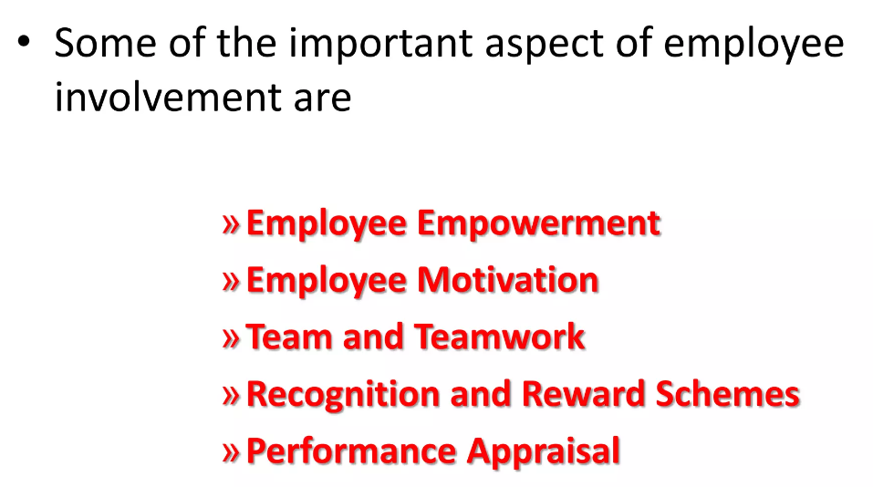

Slide 20
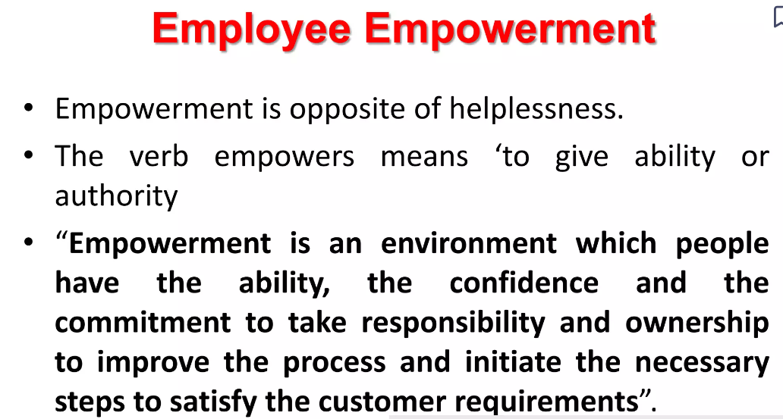

Slide 21
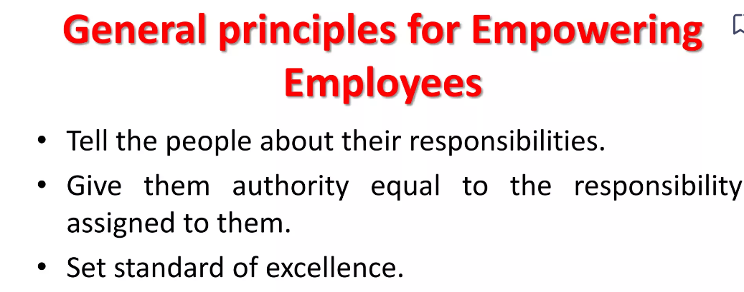
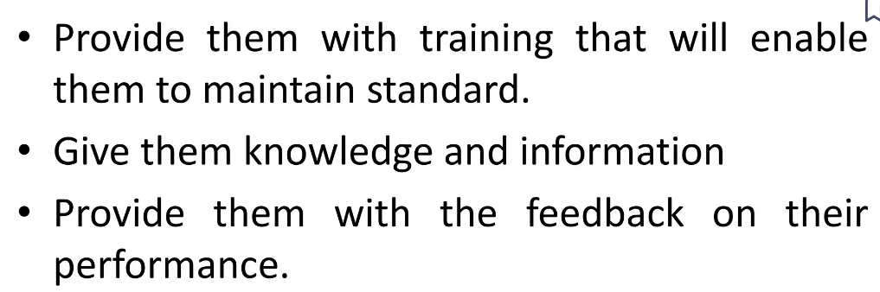

Slide 22

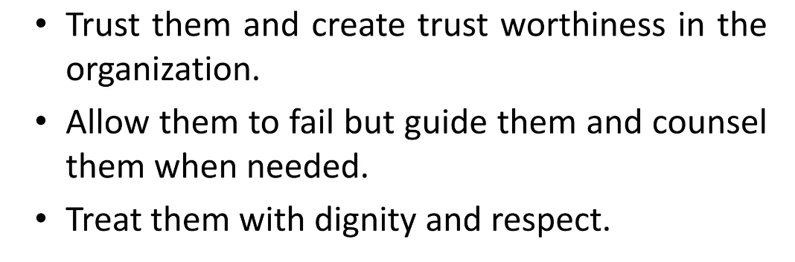

Slide 23
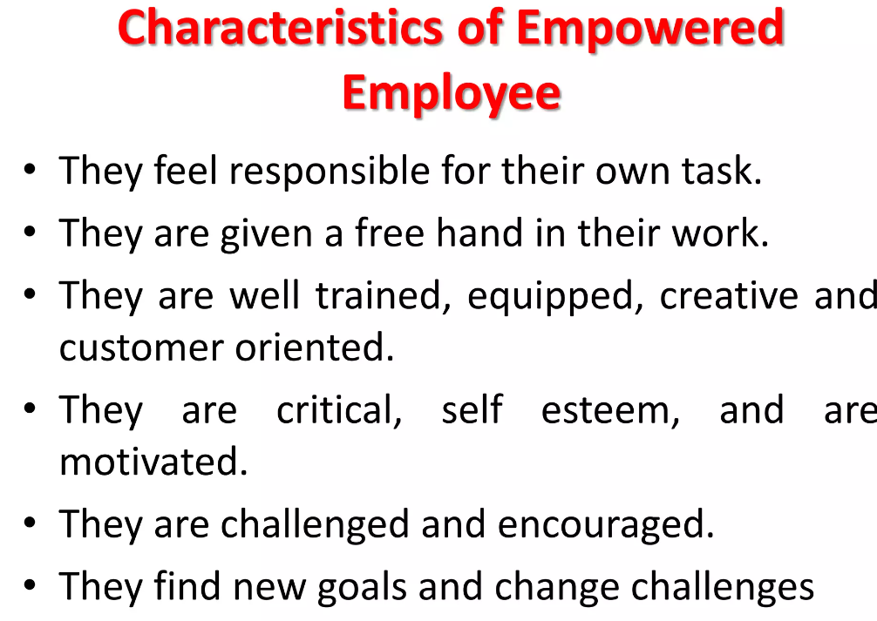

Slide 24
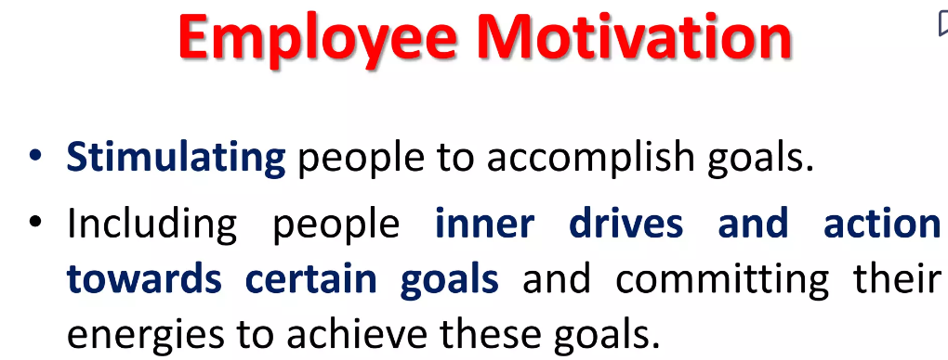
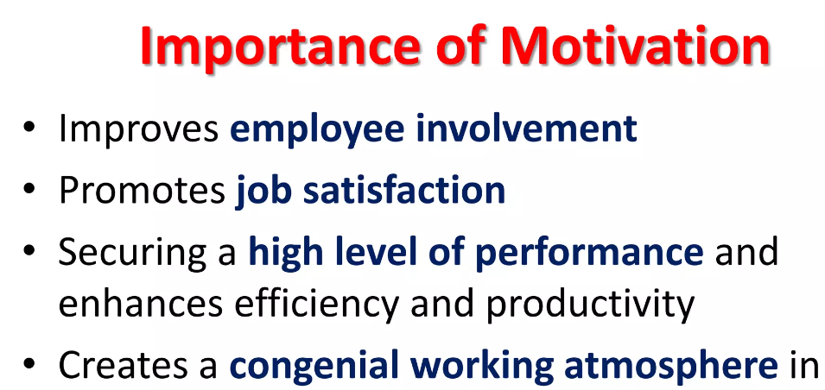


Slide 25
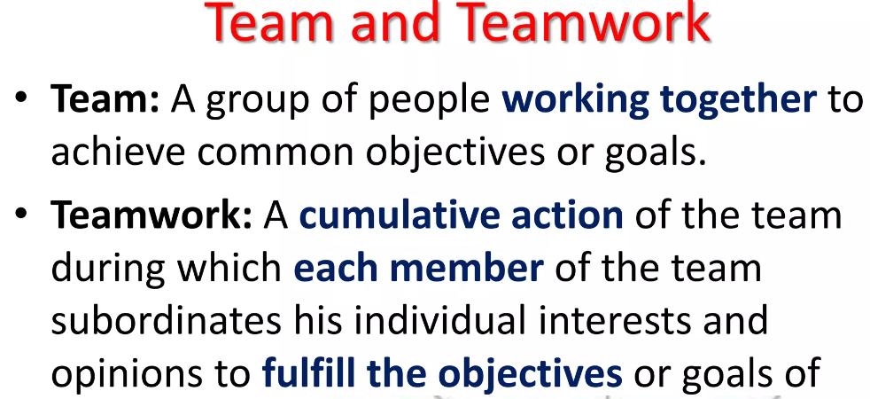


Slide 26
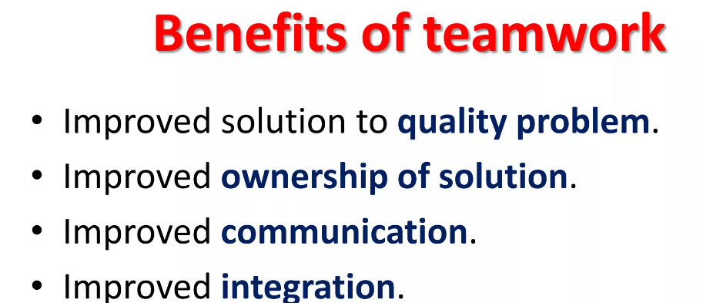

Slide 27
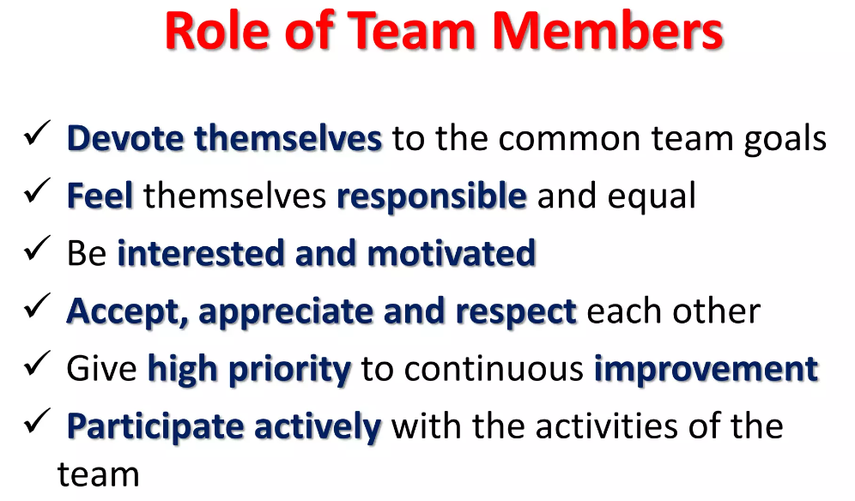

Slide 28
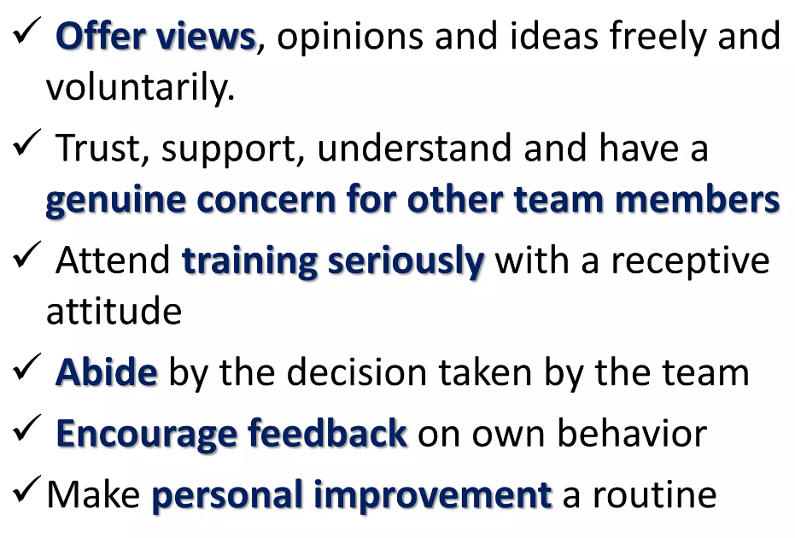

Slide 29
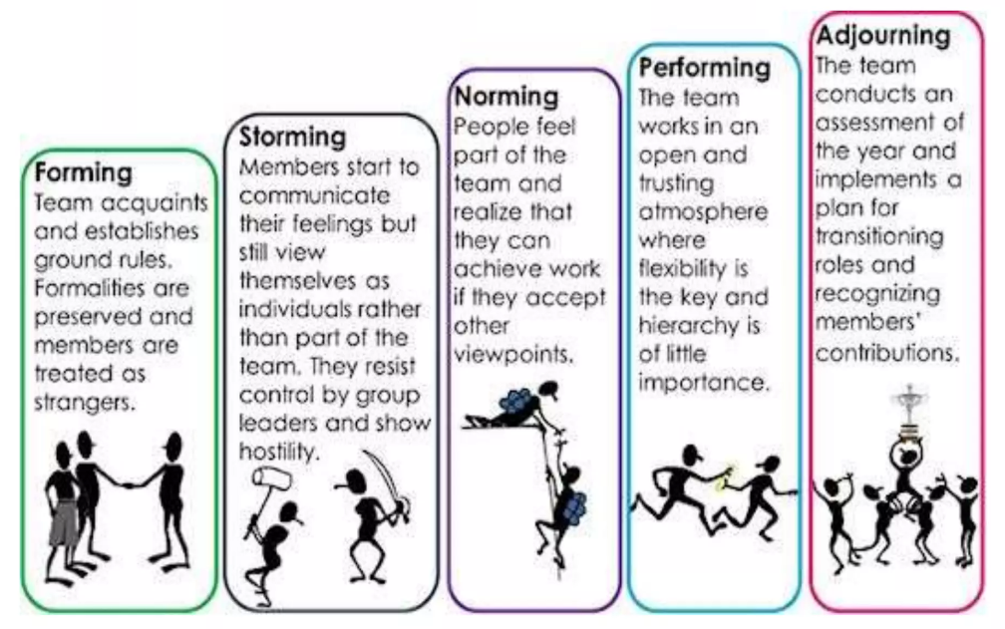

Slide 30
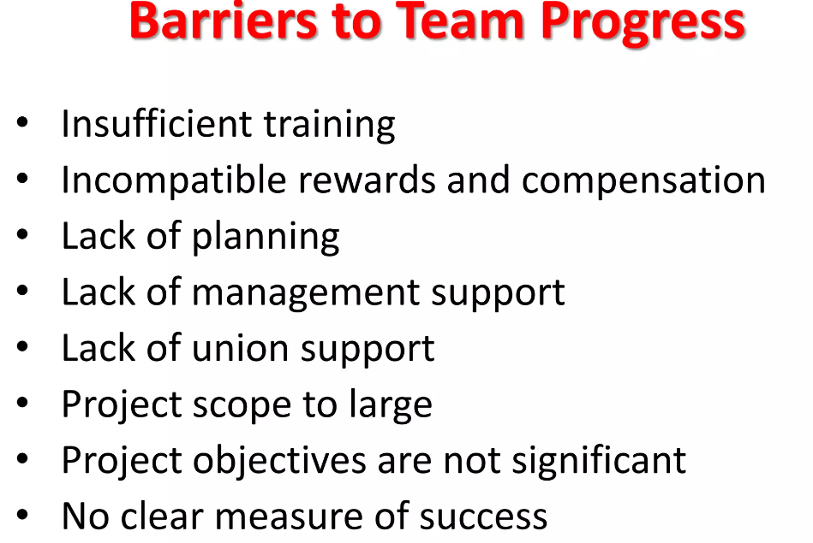

Slide 31
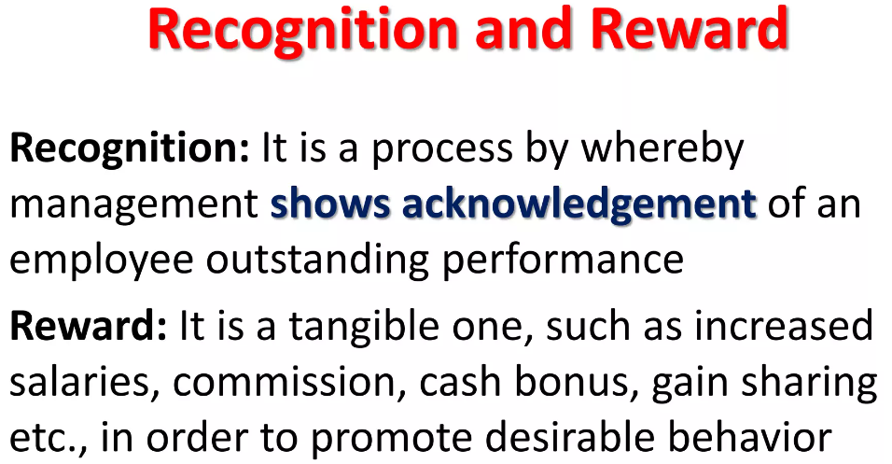

Slide 32
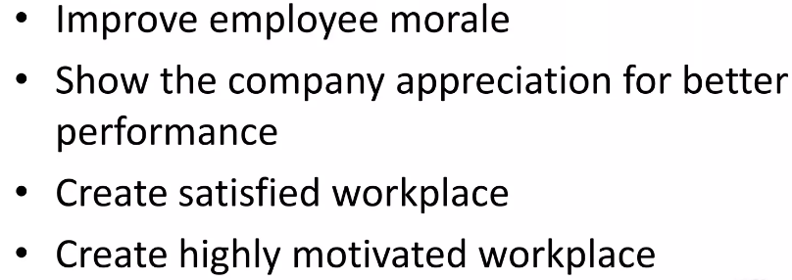
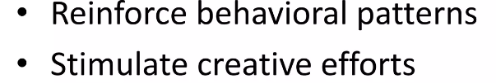

Slide 33
TYPES OF REWARDS
INTRINSIC REWARDS
1. Non-monetary forms of recognition to acknowledge achievement of quality improvement goals.
2. Celebration to acknowledge achievement of quality improvement goals.
3. Regular expressions of appreciation by managers and leaders to employees to acknowledge achievement of quality improvement goals.
4. 360 degree performance appraisals feedback from co-workers subordinates to customers is incorporated into performance appraisals.

Slide 34
EXTRINSIC REWARDS:
1. Profit sharing
2. gain sharing
3. employment security
4. compensation time
5. individual based performance systems
6. quality based performance appraisals

Slide 35
Various ways for Recognition and Rewards are
1. Recognition can be expressed using verbal and written praise.
2. Rewards may be in the form of certificates and plaques.
3. Reward is normally in the form of cinema tickets, dinner for family etc.
4. The financial compensation (for recognition) can be paid in terms of increased salaries, commissions, gain sharing etc.
5. The efforts of employees can be recognized by promotions, special job assignments etc.

Slide 36
6. A letter of appreciation from the CEO or the Top Management will increase the employee’s involvement.
7. Reward may be delayed but recognition should be in a timely basis.
8. Rewards should be appropriate to the improvement level.
9. People like to be recognized than any reward.
10.Special forms of recognition include pictures on the bulletin board, articles in news letters, letter to families etc.
11.Supervisors can give on-the-spot praise for a job which is done well.

Slide 37
EFFECTS OF RECOGNITION AND REWARD SYSTEM
1. Recognition and reward go together for letting people know that they are valuable members for the organization.
2. Employee involvement can be achieved by recognition and reward system.
3. Recognition and reward system reveals that the organization considers quality and productivity as important.
4. It provides the organization an opportunity to thank high achievers.
5. It provides employees a specific goal to achieve.
6. It motivates employees to improve the process.
7. It increases the morale of the workers.

Slide 38

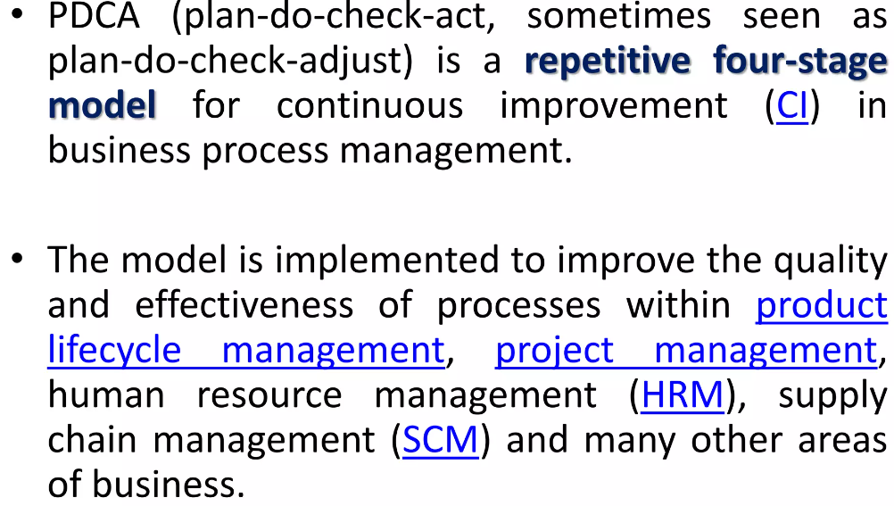

Slide 39

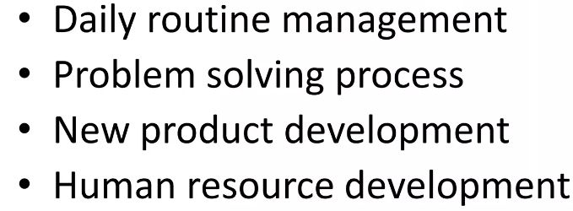
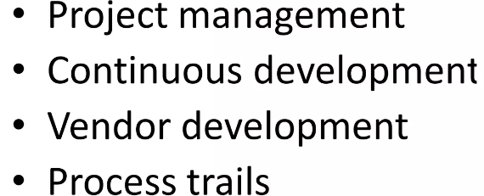

Slide 40
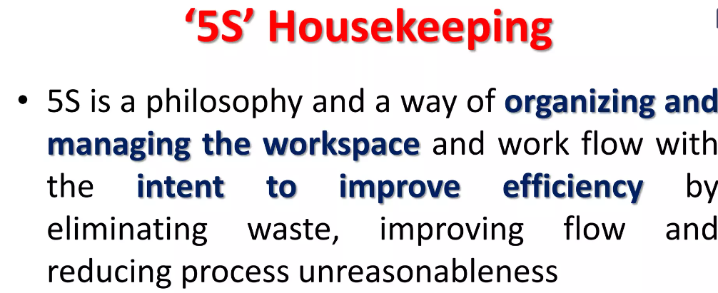

Slide 41
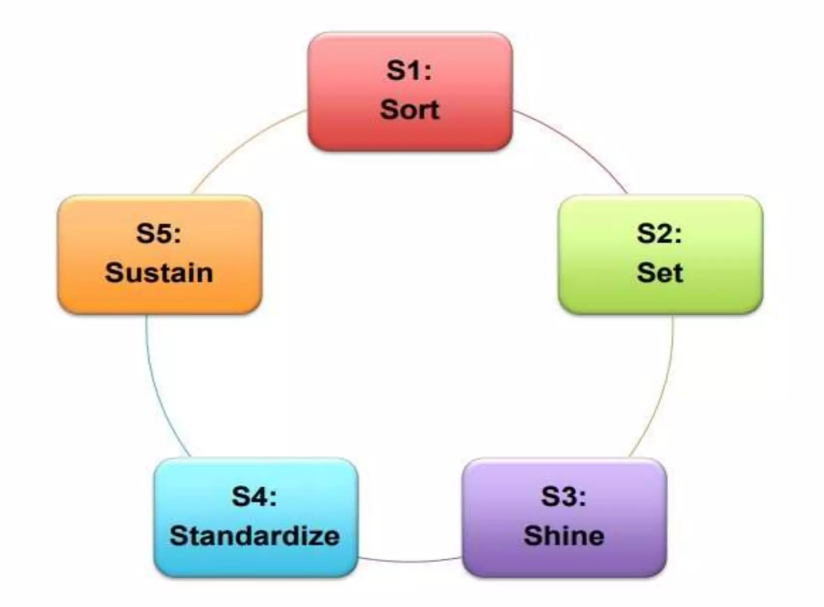
S1-SORT, S2-SET, S3-SHINE, S4-STANDARDIZE, S5-SUSTAIN

Slide 42
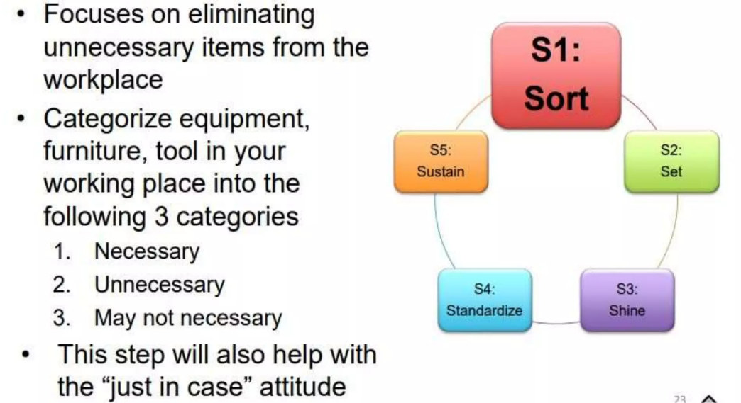

Slide 43
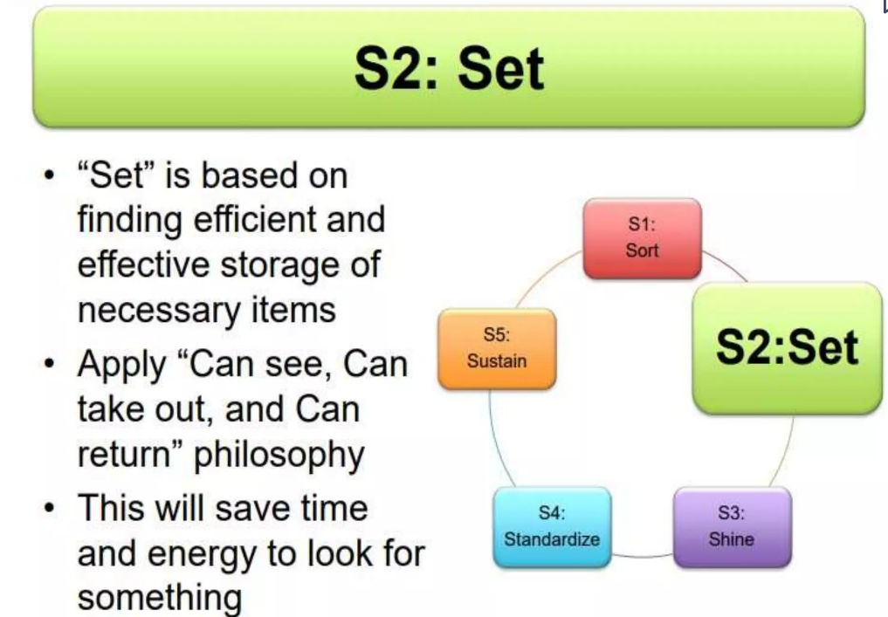

Slide 44
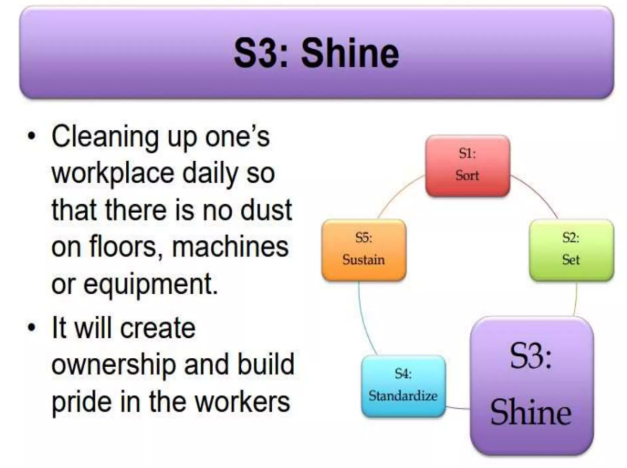

Slide 45
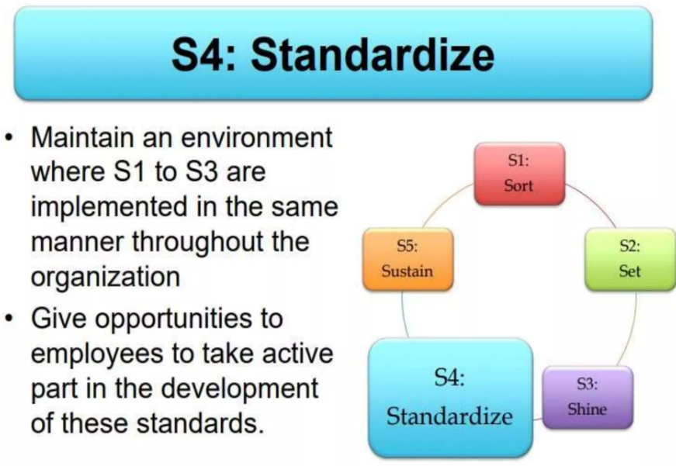

Slide 46
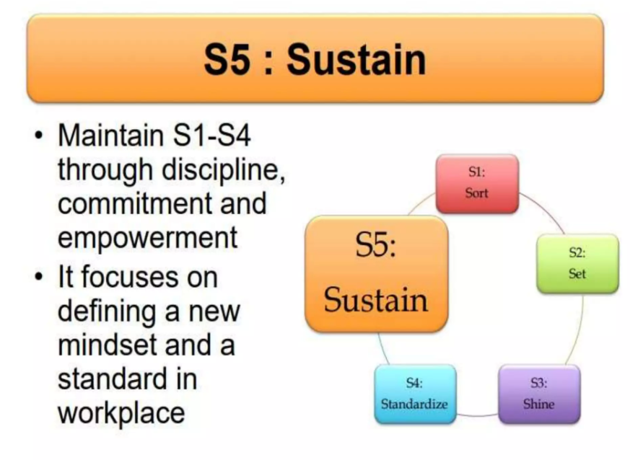

Slide 47
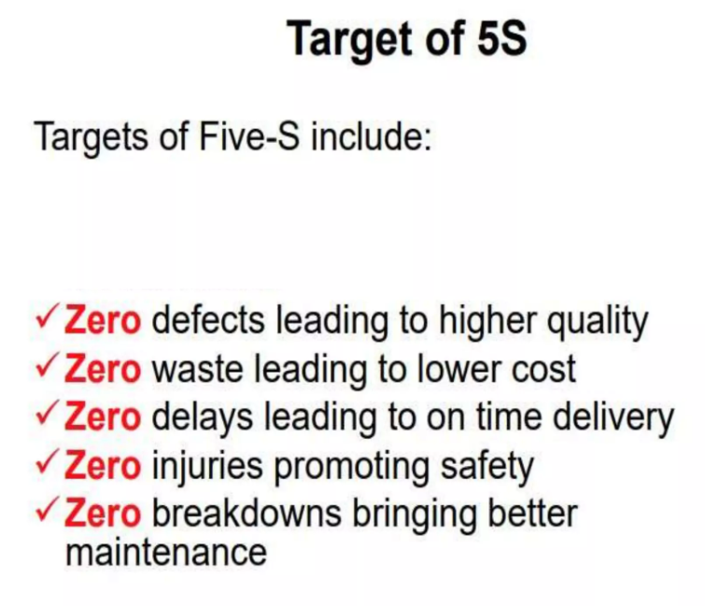

Slide 48
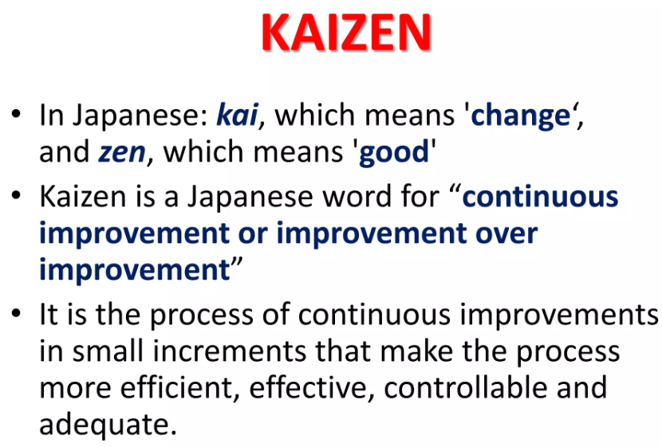

Slide 49
TQM GURUS
Total Quality Management (TQM) has been influenced by several key figures, often referred to as "TQM gurus," who have made significant contributions to the development and understanding of quality management principles. Some of the most prominent TQM gurus include:
W. Edwards Deming
An American statistician, professor, author, lecturer, and consultant, Deming is often considered the father of modern quality management. He emphasized the importance of statistical process control, continuous improvement, and the 14 Points for Management, which became fundamental to the TQM philosophy.

Slide 50
2. Joseph M. Juran
Another influential figure in the field of quality management, Juran was a management consultant and engineer. He is known for his work on quality improvement, quality control, and the concept of the "Juran Trilogy," which includes quality planning, quality control, and quality improvement.
3. Philip B. Crosby
Crosby was an author and consultant who is best known for his concept of "zero defects." He emphasized the importance of prevention rather than detection of defects and promoted the idea that quality is free – meaning that investing in quality upfront saves money in the long run.

Slide 51
4. Kaoru Ishikawa
A Japanese organizational theorist, professor, and quality management expert, Ishikawa is known for his contributions to quality management, particularly in the development of the fishbone diagram (Ishikawa diagram) for root cause analysis and his advocacy for employee involvement in quality improvement processes.
5. Genichi Taguchi
A Japanese engineer and statistician, Taguchi is best known for his work on robust engineering and the Taguchi methods, which aim to improve quality and reduce variation in manufacturing processes.

Slide 52
6. Shigeo Shingo
A Japanese industrial engineer, Shingo is known for his work on the Toyota Production System and his contributions to lean manufacturing principles. He developed several techniques, including poka-yoke (error-proofing) and SMED (Single-Minute Exchange of Die), to improve manufacturing efficiency and quality.
These TQM gurus have left a lasting legacy in the field of quality management, and their principles continue to influence organizations worldwide in their pursuit of operational excellence and customer satisfaction.

Slide 53
FACULTY VIDEO LINKS, YOUTUBE & NPTEL VIDEO LINKS AND ONLINE COURSES DETAILS
https://www.youtube.com/watch?v=Q3EOCAuExJU
https://www.youtube.com/watch?v=yWlAOFs04go
https://www.youtube.com/watch?v=QifqIoUNTJM
https://www.youtube.com/watch?v=qb3mvJ1gb9g
https://www.youtube.com/watch?v=2ePeXePNLrs
https://www.youtube.com/watch?v=HkdoR-NNEoI
https://www.researchgate.net/publication/318654507_Total_Quality_Management_Notes
http://www.mescenter.ru/images/abook_file/Total_Quality_Management_and_Six_Sigma.pdf

Slide 54
DAILY QUIZ
What do you understand by quality audit?
Briefly explain the term TQM?
Explain the different Dimensions of Quality?
Give the Basic Concepts of TQM?
Give the Principles of TQM?

Slide 55
WEEKLY ASSIGNMENT
Discuss the importance of quality culture?
Explain the difference between traditional and modern quality cultures?
How do you understand who is a customer?
Explain customer defined value, value analysis and retention.
Discuss product innovation models for customer retention?
Discuss employee empowerment?
Discuss leadership for quality?
Explain why continual quality improvement is important.

Slide 56
MCQs
What is the aim of fool proof technique used for total quality management?
a. to achieve zero defects b. to specify time schedules c. to specify targets d. none of the above
Match the following group 1 items with group 2 items 1. Sort -------------------------------------------------- A. Seitan 2. Set in order -----------------------------------------B. Seiketsu 3. Shine ------------------------------------------------ C. Seiri 4. Standardize -----------------------------------------D. Seiso
a. 1 – D, 2 – A, 3 – B, 4 – C b. 1 – C, 2 – A, 3 – D, 4 – B c. 1 – B, 2 – C, 3 – A, 4 – D d. 1 –A, 2 – C, 3 – D, 4 – B

Slide 57
MCQs
MCQs
Which quality management program is related to the maintenance of plants and equipments?
a. Environmental management systems b. Fault tree analysis c. Failure mode effect analysis d. Total productive maintenance
Which part in quality management is the critical part? a) Process thinking b) Performance measurement c) Customer’s view d) Systematic approach

Slide 58
MCQs
MCQs
What is the full form of TQM? a) True quality machining b) Total quality management c) True quantitative machining d) Total queue management
Which of the following is correct for TQM? a) Quality strategy in TQM emanates from top b) TQM is a static process c) It is a management approach to short-term success through customer d) It is used to improve processes not products

Slide 59
MCQs
MCQs
Which factor is the basis of Decision making in TQM? a) Facts only b) Opinions only c) Facts and opinions both d) Neither facts nor opinions
According to Deming, Quality problems are
a. Due to management
b. Due to method
C . Due to machine
d. Due to material

Slide 60
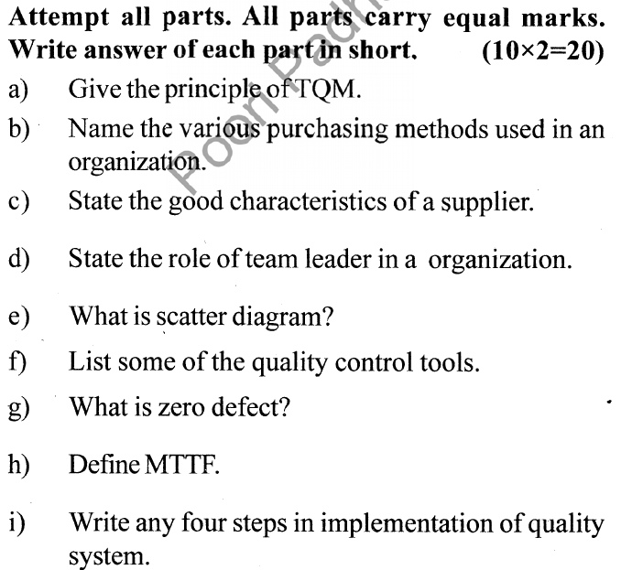
OLD QUESTION PAPERS

Slide 61
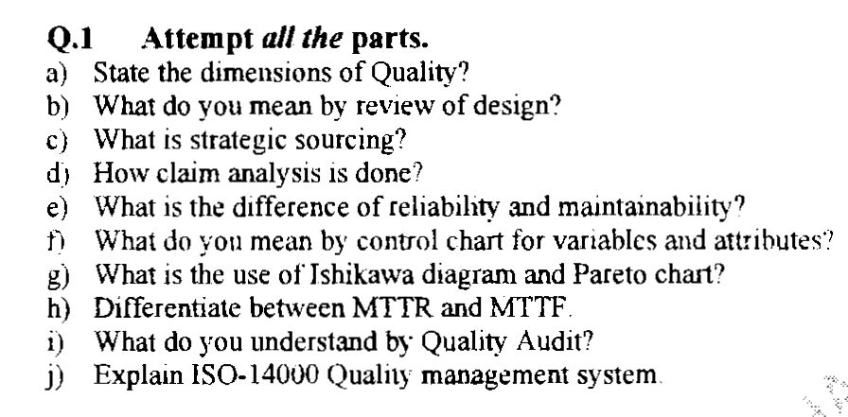
OLD QUESTION PAPERS
OLD QUESTION PAPERS

Slide 62
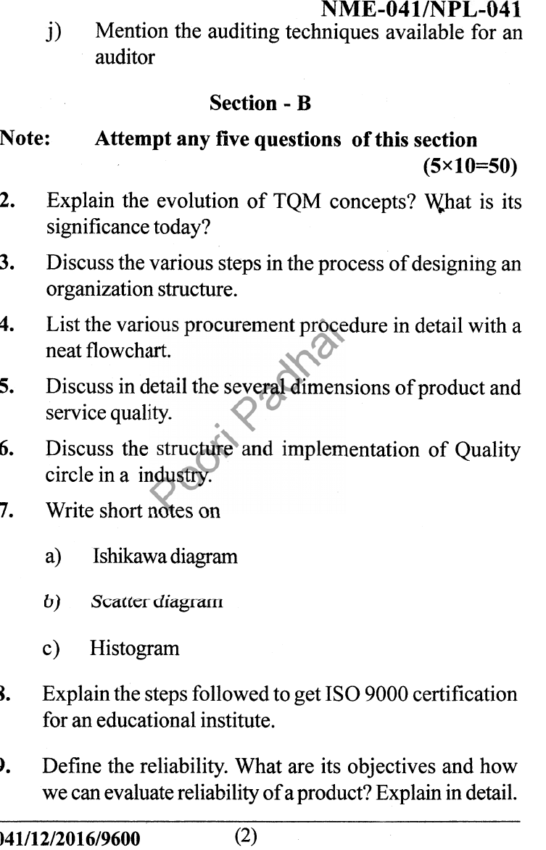
OLD QUESTION PAPERS
OLD QUESTION PAPERS

Slide 63
EXPECTED QUESTIONS FOR UNIVERSITY EXAM
Explain the different Dimensions of Quality?
Give the Basic Concepts of TQM?
Give the Principles of TQM?
Explain the Obstacles associated with TQM Implementation?
What is needed for a leader to be effective?
What are the general duties of a quality council?
Explain the important factors that influence customer purchases?

Slide 64
EXPECTED QUESTIONS FOR UNIVERSITY EXAM
EXPECTED QUESTIONS FOR UNIVERSITY EXAM
What are the types of teams?
What are the stages of team development?
Give some common team problems?
Give the steps involved in training process?
What are the three components of the Juran Trilogy?
What are the phases of a Continuous Process Improvement Cycle?

Slide 65
SUMMARY
TQM encourages participation amongst employees, managers and organization as whole.
Using Quality management reduces rework nearly to zero in an achievable goal .The responsibilities either its professional, social, legal one that rest with the pharmaceutical manufacturer for the assurance of quality of product are tremendous and it can only be achieved by well organised.
Work culture and complete engagement of the employees at the work place. It should be realised that national & international regulations must be implemented systematically and process.
Control should be practiced rigorously.

Slide 66
SUMMARY
SUMMARY
Thus quality is critically important ingredient to organizational success today which can be achieved by TQM, an organizational approach that focuses on quality as an over achieving goals, aimed at aimed at the prevention of defects rather than detection of defects

Slide 67
REFERENCES
Text Book
Lt. Gen. H. Lal, “Total Quality Management”, Eastern Limited
Greg Bounds, “Beyond Total Quality Management”, McGraw Hill
Menon, H.G, “TQM in New Product manufacturing”, McGraw Hill
Reference Book
Total Quality Management” by Besterfield
“Total Quality Management” by Mukherjee
Total Quality Management” by Vijayan
“Total Quality Management- Text and Cases” by Janakiraman B and Gopal R K
https://www.researchgate.net/publication/318654507_Total_Quality_Management_Notes

Slide 68
Thank You

